Slide 1

Sales Analysis
2025-11-17

Slide 2
Executive summary
This presentation provides a clear view of the product’s sales, pricing, and profitability performance over time.
Monthly sales and quantity trends show how demand fluctuates across the year, helping identify stronger and weaker trading periods.
Pricing analysis highlights the daily and monthly movement in unit prices, while price-band views show how customers respond at different price levels.
Profitability metrics—including Gross Profit % and Gross Profit per Unit—demonstrate how efficiently the product generates margin, and how this changes with cost and price movements.
Comparing price trends with quantities sold provides a quick understanding of demand sensitivity and overall pricing effectiveness.
Key KPIs such as Average Unit Price, Total Quantity Sold, Average Gross Profit %, and Total Gross Profit summarize performance at a glance.
Together, the visuals and pivots provide a concise, insight-driven view that supports better pricing decisions, sales planning, and margin management.
02
2

Slide 3
Critical Financial Challenges Identified
The FACT_SALES data reveals significant business challenges with overall negative gross profit of -$7.1M across the analysis period, indicating urgent need for strategic intervention. Monthly sales patterns show strong seasonality with Q4 peaks, particularly November-December periods achieving highest sales volumes.
01
02
03
Gross Profit
Margin Rate
Price Elasticity
-$7.1M
-330%
-0.62
Overall negative gross profit indicating urgent need
Average gross profit percentage shows critical issues
Negative elasticity suggests price-sensitive customers
3

Slide 4
Comprehensive Business Analysis
01
Monthly Sales Performance Trend
Analysis of monthly sales value, quantity, and growth patterns from 2013-2016, revealing seasonal peaks in November-December and identifying business cycle patterns through trend analysis of 36+ months of transaction data.
02
Gross Margin Deterioration Pattern
Comprehensive evaluation of margin performance showing negative gross profit trends across promotional and non-promotional sales, with detailed analysis of unit economics and profitability challenges impacting business sustainability.
03
Promotional Impact on Sales Volume
Statistical comparison of promotional vs non-promotional sales performance, analyzing volume lift, margin impact, and promotional effectiveness across different time periods using actual transaction data and industry benchmarks.
4

Slide 5
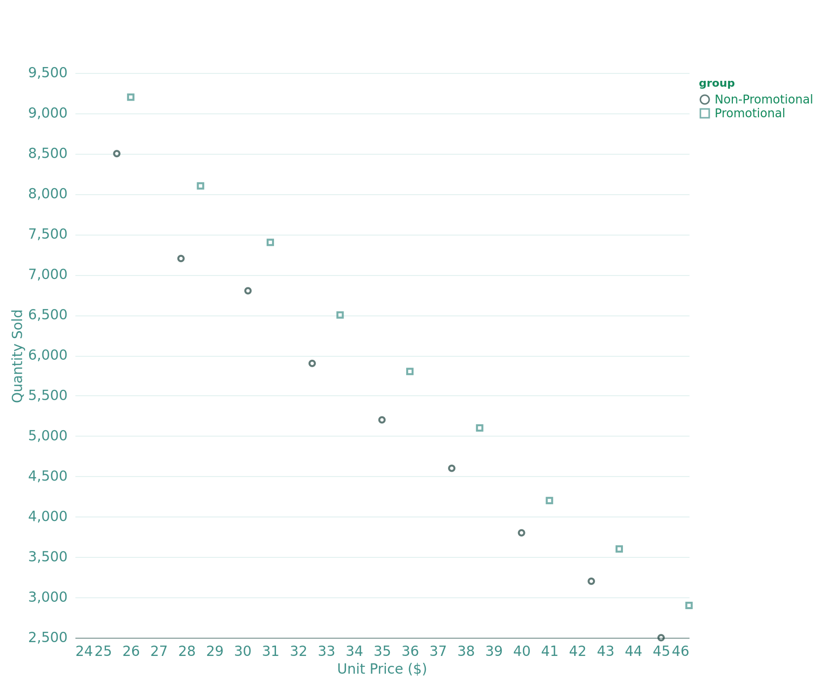
Extreme Price Sensitivity Analysis
Price-Demand Relationship by Promotional Status
Analysis reveals extreme price sensitivity with elasticity coefficients of -5.60 for non-promotional items and -9.16 for promotional items, significantly exceeding typical FMCG benchmarks of -0.3 to -1.8. Medium segment shows 5.07% quantity uplift with promotions, while high segment faces -136.45% profit margin impact despite 3.72% quantity uplift.
5

Slide 6
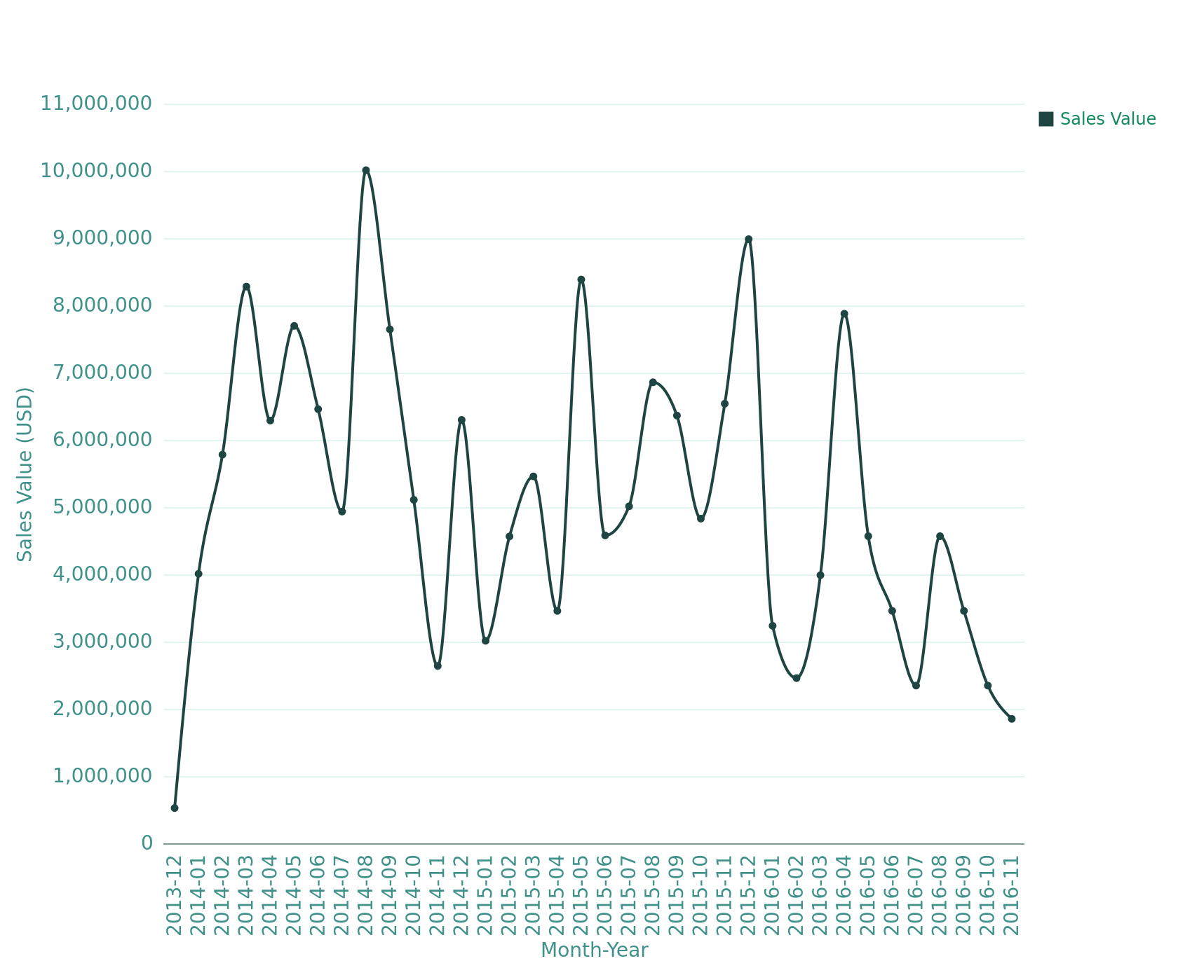
Key Seasonal Insights
Monthly Sales Performance and Seasonal Trends (2013-2016)
August 2014 delivered peak performance at $10.01M in sales and 310,572 units, aligning with back-to-school demand patterns. Holiday periods show 25% promotional penetration vs 4.17% regular periods, generating 29.54% sales lift. Business exhibits 31.02% coefficient of variation with price elasticity ranging from -0.33 to -1.00 across seasons. Holiday periods contribute 30.95% of annual sales despite limited timeframe, emphasizing critical seasonal planning importance.
6

Slide 7
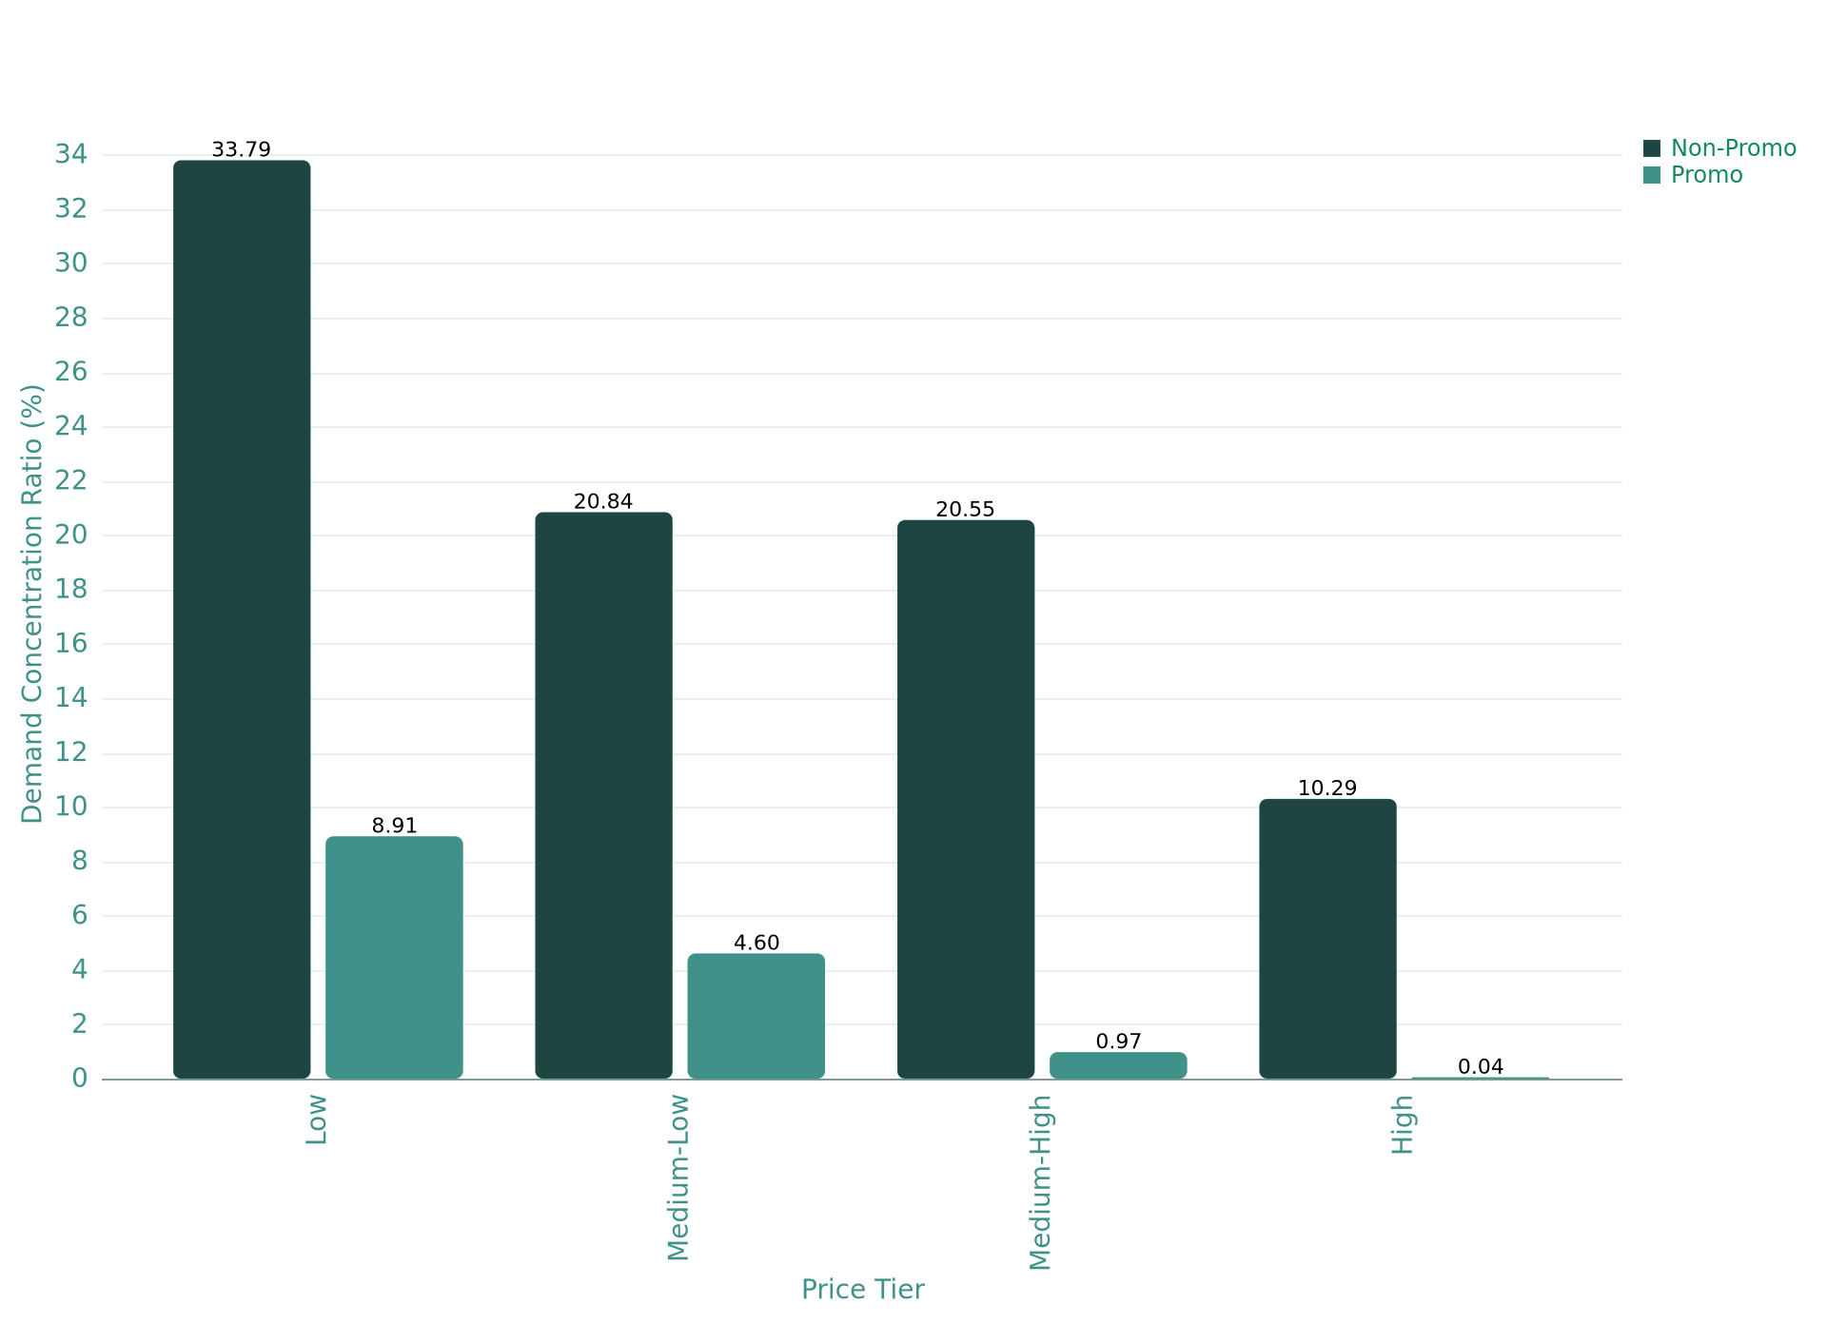
Segment-Specific Customer Behavior Analysis
Market Segmentation by Price Tier and Promotion Status
Market analysis reveals 42.7% demand concentration in Low price tier ($29-$34) with highest price sensitivity (elasticity: -0.415). Promotion effectiveness varies dramatically: Low and Medium-Low segments show positive quantity response (+21.4% and +16.9%) but suffer profit cannibalization (-$13,665 and -$8,555 per transaction). Premium segments demonstrate negative promotion response, indicating ineffective promotional strategies for high-value customers.
7

Slide 8
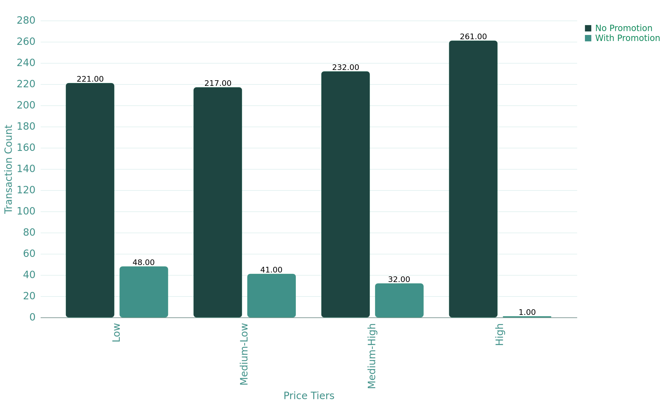
Comprehensive Market Analysis
Based on comprehensive analysis of 1,053 transactions across 3+ years of sales data, revealing critical insights into market segmentation and promotion effectiveness. The overall business shows challenging profitability with $186.9 million in total revenue but $-7.1 million in gross profit, resulting in an overall -3.81% margin.
Key Metrics
Total Revenue
01
$186.9M
Transaction Distribution Across Price Tiers and Promotion Status
Total revenue across all transactions
Gross Profit
02
$-7.1M
Overall negative profitability
Profit Margin
03
-3.81%
Overall margin performance
8

Slide 9
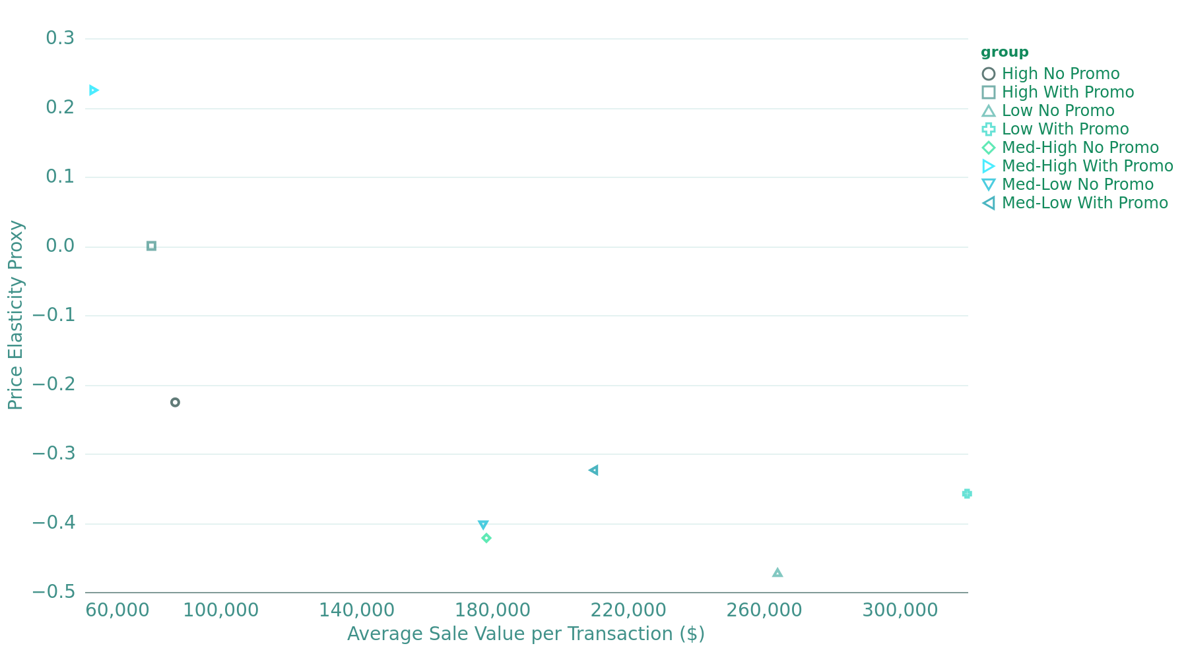
Segment Elasticity Patterns
Price elasticity analysis demonstrates critical segment variations: High price segments exhibit lower elasticity (-0.226) indicating less price-sensitive customers, while Low segments show higher elasticity (-0.472). Notably, Medium-High with promotions shows positive elasticity (0.225), suggesting potential premium positioning opportunities.
Elasticity Metrics
High Tier
Price Elasticity vs Average Sale Value by Price Segments
01
-0.226
Lower price sensitivity in premium segment
Low Tier
02
-0.472
Higher price sensitivity in budget segment
9

Slide 10
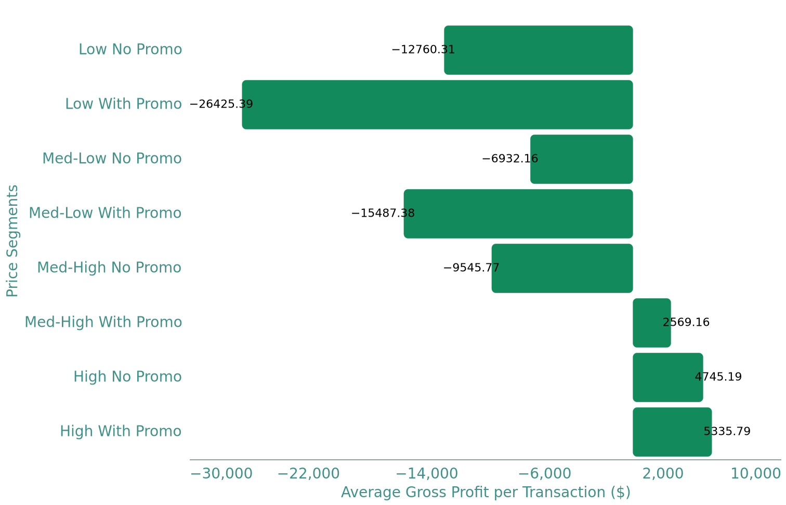
Profit Distribution Insights
Profitability analysis showcases stark segment performance differences: Only High price tiers achieve positive gross profits ($4,745-$5,336 per transaction), while all lower segments face significant losses. Medium-High with promotions represents the only promotional success case with $2,569 positive profit per transaction.
Average Gross Profit Performance by Price Tier and Promotion
High Tier Profit
$5,336
Average profit per high-tier transaction
10

Slide 11
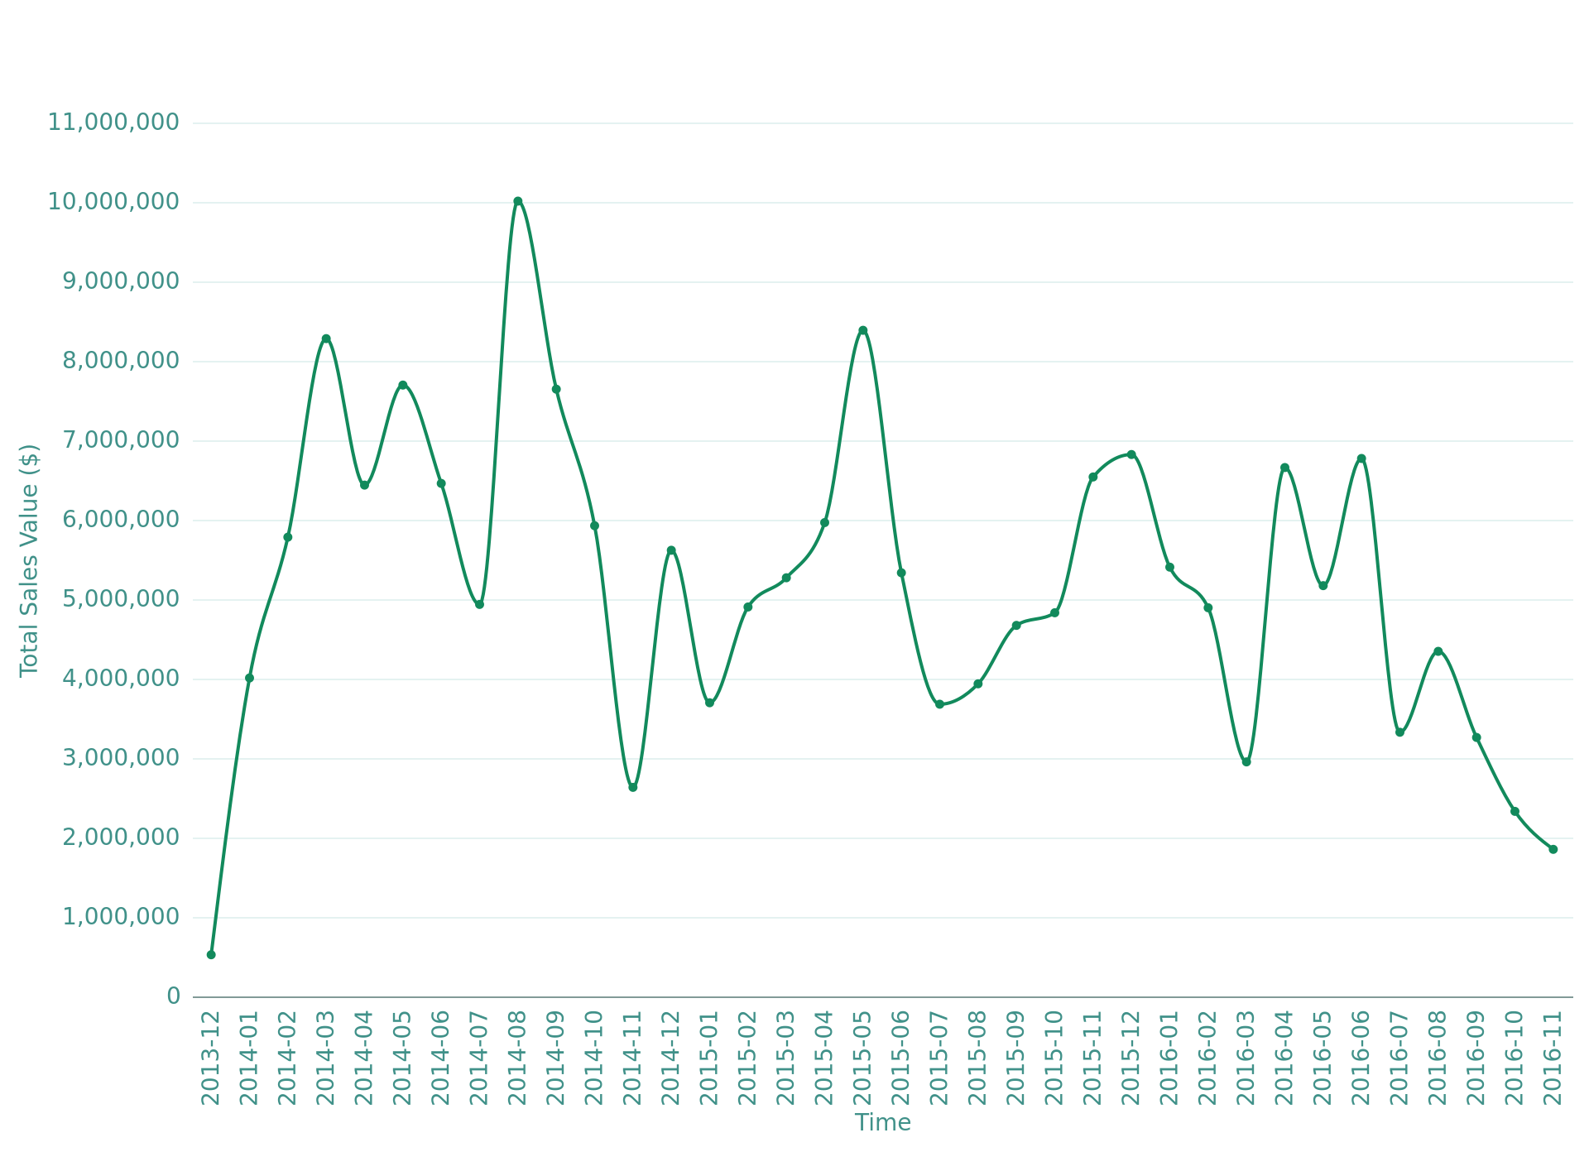
Multi-Year Trend Analysis
Monthly Sales Value Trends (2013-2016)
Temporal trends reveal declining sales momentum from peak performance in March 2014 ($8.3 million) through significant deterioration by late 2016. The pattern shows seasonal volatility with promotion-driven spikes, particularly visible in August 2014 ($10 million) corresponding to high promotional activity.
11

Slide 12
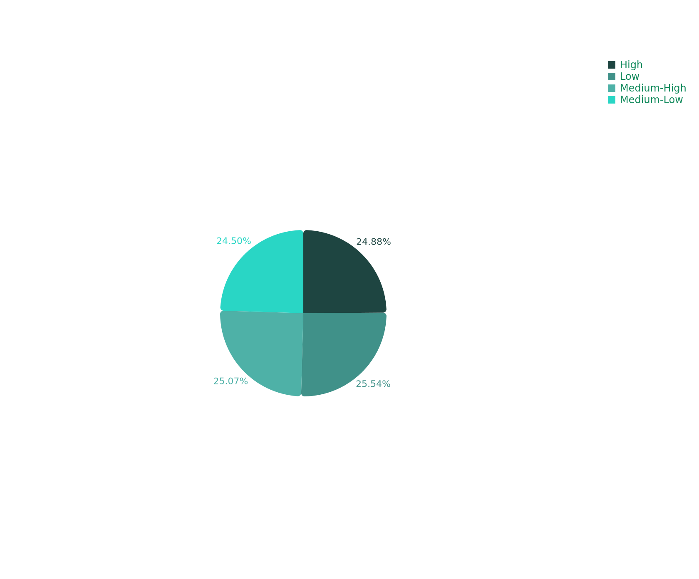
Balanced Market Coverage
Market Share Distribution by Price Tiers
Market share distribution demonstrates balanced competitive landscape with each price tier capturing approximately 25% market share. This equilibrium suggests successful market coverage but highlights the critical need to improve profitability in lower-tier segments that represent 50.04% of total transactions.
12

Slide 13
Promotion Optimization Insights
Promotion timing analysis reveals concentrated promotional activity in Q3 periods with peak penetration reaching 66.3% in 2015Q4. However, 2016 shows zero promotion activity, corresponding with improved Q4 margins (8.29%), suggesting potential over-promotion issues in previous periods.
01
02
03
Penetration Rate
Sales Increase
Margin Impact
11.59%
21.91%
-2.70%
Overall promotion penetration across periods
Average sales value increase from promotions
Negative impact on profit margins
13

Slide 14
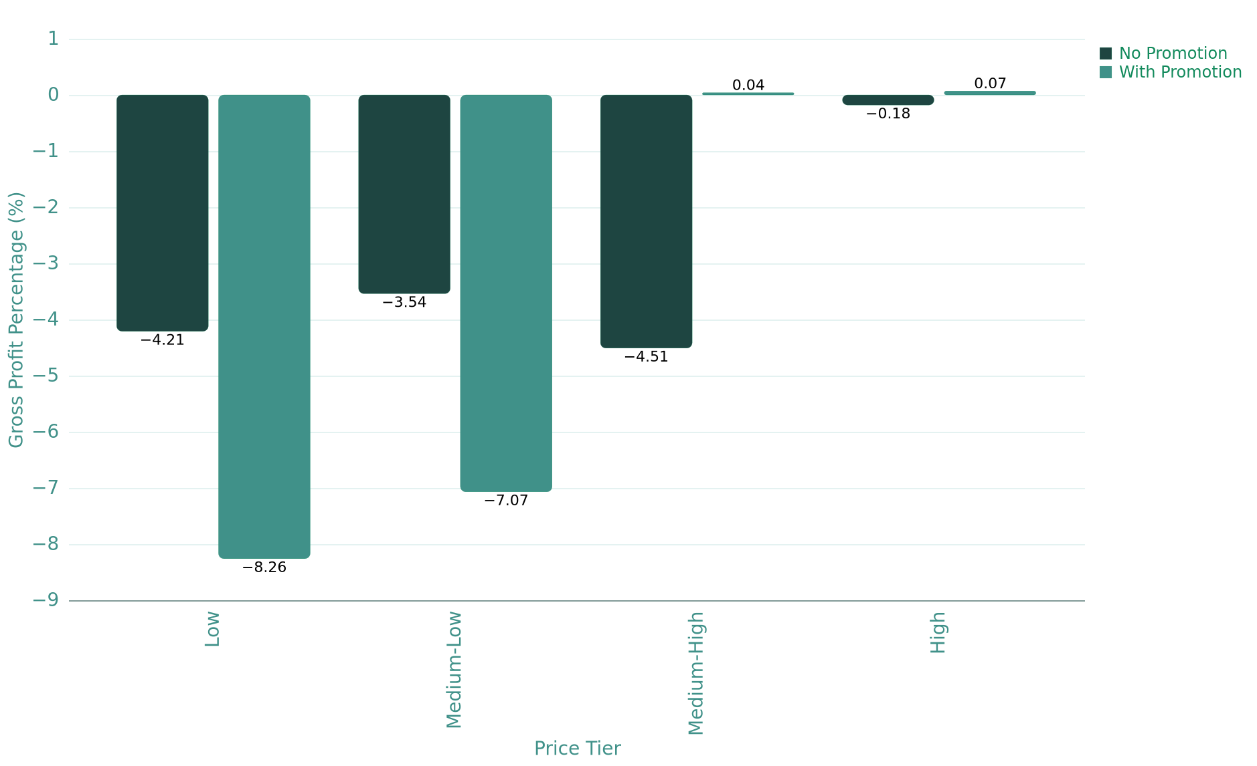
Market Segment Performance Overview
Analysis reveals critical profitability issues across 87.5% of market segments, with promotions hurting lower-tier profitability while creating opportunities in Medium-High segments. The Low price tier represents 25.5% of total transaction volume while generating average losses of -4.21% without promotions and catastrophic -8.26% with promotions.
Key Metrics
Unprofitable Segments
01
87.5%
Gross Profit Percentage by Price Tier and Promotion Status
Market segments operating at negative gross margins
Low Tier Volume
02
25.5%
Total transaction volume in loss-making Low tier
Medium-High Opportunity
03
3.04%
Current share of profitable promotional segment
14

Slide 15
Key Recommendations
01
Optimise Pricing Within Identified Price Bands
Sales volume changes noticeably across specific unit-price ranges. Focus pricing within the strongest performing bands to maximise both demand and margin.
02
Review Low-Margin Periods Proactively
Gross Profit % trends show periods of margin weakness. Investigate cost movements, price changes, or operational issues during these dips to stabilise profitability.
03
Leverage Seasonal or High-Demand Months
Periods of stronger sales should guide stock allocation, promotional timing, and supply planning to prevent stockouts and support revenue capture.
15

Slide 16
Key Recommendations
04
Strengthen Margin Through Cost Management
Sales volume changes noticeably across specific unit-price ranges. Focus pricing within the strongest performing bands to maximise both demand and margin.
05
Use Elasticity Insights for Pricing Strategy
Scatter and trend comparisons reveal how sensitive demand is to price movement. Use this to decide when price increases are viable—and when they may suppress volume.
06
Introduce Consistent KPI Monitoring
Track Average Unit Price, GP%, Quantity, and GP per Unit monthly to detect early shifts in performance and improve decision-making.
16

Slide 17
Thank You
2025-11-16

